Slide 1
Processing Sequences

Slide 2
RNNs
we will discuss recurrent neural networks (RNNs)—a class of nets that can predict the future (well, up to a point). RNNs can analyze time series data
as the number of daily active users on your website, the hourly temperature in your city, your home’s daily power consumption, the trajectories of nearby cars, and more. Once an RNN learns past patterns in the data, it is able to use its knowledge to forecast the future

Slide 3
The Simplest Possible RNN
One neuron receiving inputs, producing an output and sending that output back to itself.

Slide 4
The simplest possible RNN
At each time step t (also called a frame), this recurrent neuron receives the inputs x(t) as well as its own output from the previous time step, ŷ(t-1) . Since there is no previous output at the first time step, it is generally set to 0.
We can represent this tiny network against the time axis. This is called unrolling the network through time (it’s the same recurrent neuron represented once per time step).

Slide 5
A layer of RNN
At each time step t, every neuron receives both the input vector x(t) and the output from the previous time step , ŷ(t-1). Now both the input and outputs are vectors.

Slide 6
A layer of RNN

Slide 7
Calculating output
Each recurrent neuron has two sets of weights: one for the inputs x and the other for the outputs of the previous time step, ŷ . Let’s call these weight vectors w_{x} and w_{ŷ} .
If we consider the whole recurrent layer instead of just one recurrent neuron, we can place all the weight vectors in two weight matrices: W_{x} and W_{ŷ}

Slide 8

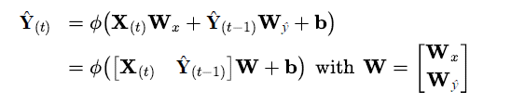
Output of RNN
Output
With a mini batch

Slide 9
Memory Cells
Since the output of a recurrent neuron at time step t is a function of all the inputs from previous time steps, you could say it has a form of memory
A single recurrent neuron, or a layer of recurrent neurons, is a very basic cell, capable of learning only short patterns (typically about 10 steps long, but this varies depending on the task)
we will look at some more complex and powerful types of cells capable of learning longer patterns (roughly 10 times longer)

Slide 11
Sequence to sequence network
An RNN can simultaneously take a sequence of inputs and produce a
sequence of outputs. This type of sequence-to-sequence network is useful to forecast time series, such as your home’s daily power consumption: you feed it the data over the last N days, and you train it to output the power consumption shifted by one day into the future (i.e., from N – 1 days ago to tomorrow).

Slide 12
Sequence-to-vector
In sequence to vector network, you feed the network a sequence of inputs and ignore all outputs except for the last one.
For example, you could feed the network a sequence of words corresponding to a movie review, and the network would output a sentiment score (e.g., from 0 [hate] to 1 [love]).

Slide 13
Vector to sequence Network
feed the network the same input vector over and over again at each time step and let it output a sequence
For example, the input could be an image (or the output of a CNN), and the output could be a caption for that image.

Slide 14
Encoder decoder
Lastly, you could have a sequence-to-vector network, called an encoder, followed by a vector-to-sequence network, called a decoder.
For example, this could be used for translating a sentence from one language to another. You would feed the network a sentence in one language, the encoder would convert this sentence into a single vector representation, and then the decoder would decode this vector into a sentence in another language.

Slide 15
Training RNNs

Slide 16
Forecasting a time series
Build a model capable of forecasting the number of passengers that will ride on bus and rail the next day.
You have access to daily ridership data since 2001. Let’s walk through together how you would handle this.
15_processing_sequences_using_rnns_and_cnns.ipynb - Colaboratory (google.com)

Slide 17
Forecasting a time series
Let’s plot the bus and rail ridership

Slide 18
Forecasting a time series
This is a time series: data with values at different time steps, usually at regular intervals. More specifically, since there are multiple values per time step, this is called a multivariate time series. If we only looked at the bus column, it would be a univariate time series, with a single value per time step.
we can see that a similar pattern is clearly repeated every week. This is called a weekly seasonality.
Naïve forecasting: simply copying a past value to make our forecast. Naïve forecasting is often a great baseline

Slide 19
Forecasting a time series
The MAE, MAPE, and MSE are among the most common metrics you can use to evaluate your forecasts. As always, choosing the right metric depends on the task. For example, if your project suffers quadratically more from large errors than from small ones, then the MSE may be preferable, as it strongly penalizes large errors.

Slide 20
Forecasting a time series : differencing

Slide 21
Forecasting a time series
differencing is a common technique used to remove trend and seasonality from a time series:
it’s easier to study a stationary time series, meaning one whose statistical properties remain constant over time, without any seasonality or trends.
Once you’re able to make accurate forecasts on the differenced time series, it’s easy to turn them into forecasts for the actual time series by just adding back the past values that were previously subtracted.

Slide 22
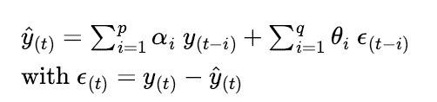
Autoregressive moving average (ARMA) model
It computes its forecasts using a simple weighted sum of lagged values and corrects these forecasts by adding a moving average
the moving average component is computed using a weighted sum of the last few forecast errors

Slide 23
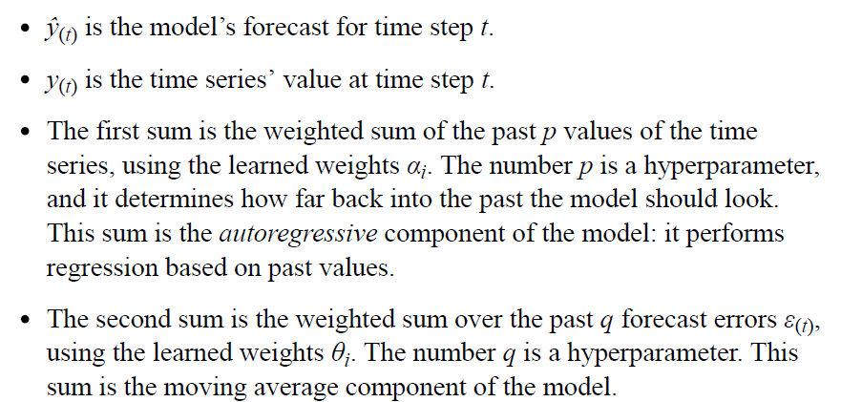
Autoregressive moving average (ARMA) model

Slide 24
Differencing
Importantly, this model assumes that the time series is stationary. If it is not,
then differencing may help. Using differencing over a single time step will
produce an approximation of the derivative of the time series: indeed, it will
give the slope of the series at each time step. This means that it will
eliminate any linear trend, transforming it into a constant value. For
example, if you apply one-step differencing to the series [3, 5, 7, 9, 11], you
get the differenced series [2, 2, 2, 2].

Slide 25
Differencing
If the original time series has a quadratic trend instead of a linear trend, then
a single round of differencing will not be enough. For example, the series
[1, 4, 9, 16, 25, 36] becomes [3, 5, 7, 9, 11] after one round of differencing,
but if you run differencing for a second round, then you get [2, 2, 2, 2]. So,
running two rounds of differencing will eliminate quadratic trends. More
generally, running d consecutive rounds of differencing computes an
approximation of the d order derivative of the time series, so it will
eliminate polynomial trends up to degree d. This hyperparameter d is called
the order of integration.

Slide 26
Autoregressive integrated moving average (ARIMA) model
This model runs d rounds of differencing to make the time series more stationary, then it applies a regular ARMA model.
When making forecasts, it uses this ARMA model, then it adds back the terms that were subtracted by differencing.

Slide 27
Seasonal ARIMA (SARIMA)
It models the time series in the same way as ARIMA, but it additionally models a seasonal component for a given frequency (e.g.,weekly), using the exact same ARIMA approach

Slide 28
Deep learning Model
Our goal will be to forecast tomorrow’s ridership based on the ridership of the past 8 weeks of data (56 days). The inputs to our model will therefore be sequences (usually a single sequence per day once the model is in production), each containing 56 values from time steps t – 55 to t. For each input sequence, the model will output a single value: the forecast for time step t + 1.

Slide 29
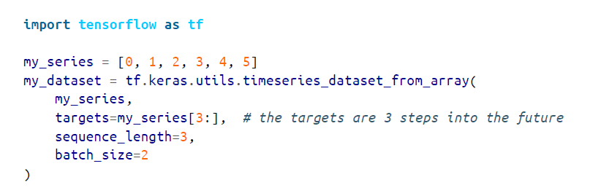

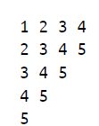
Data Preperation

Slide 30
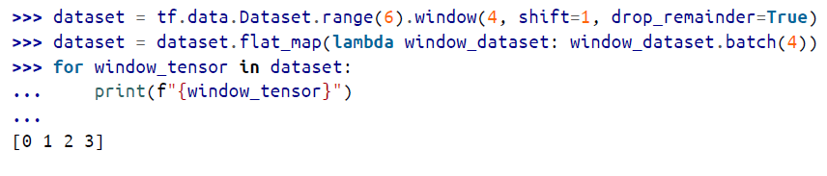

Flatten the list

Slide 31
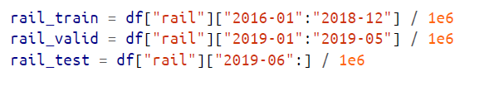
Split the data

Slide 32
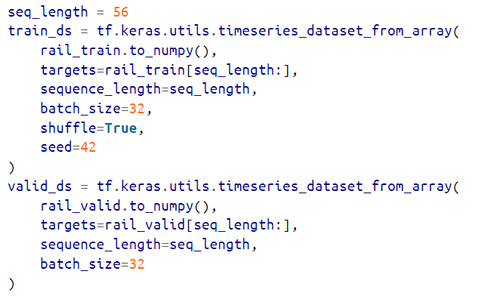
Create datasets

Slide 33
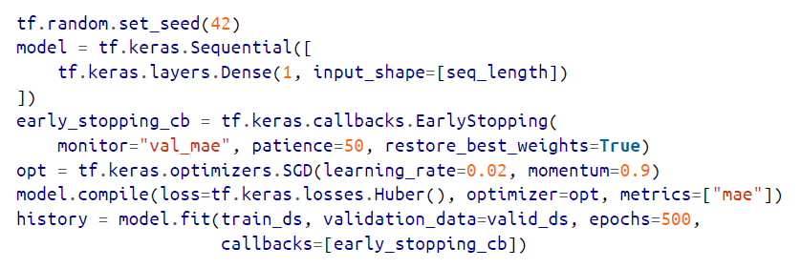
Forecasting using a linear model

Slide 34

Forecasting using a simple RNN

Slide 35
Forecasting using a simple RNN
All recurrent layers in Keras expect 3D inputs of shape [batch size, time steps, dimensionality], where dimensionality is 1 for univariate time series and more for multivariate time series
Now if you compile, train, and evaluate this model just like the previous model, you will find that it’s no good at all: its validation MAE is greater than 100,000

Slide 36
Investigating performance
The model only has a single recurrent neuron, so the only data it can use to make a prediction at each time step is the input value at the current time step and the output value from the previous time step.
That’s not much to go on! In other words, the RNN’s memory is extremely limited: it’s just a single number, its previous output.
The time series contains values from 0 to about 1.4, but since the default activation function is tanh, the recurrent layer can only output
values between –1 and +1. There’s no way it can predict values between 1.0 and 1.4.

Slide 37
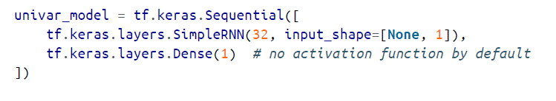
Fix

Slide 38
Forecasting Using Deep RNN

Slide 39
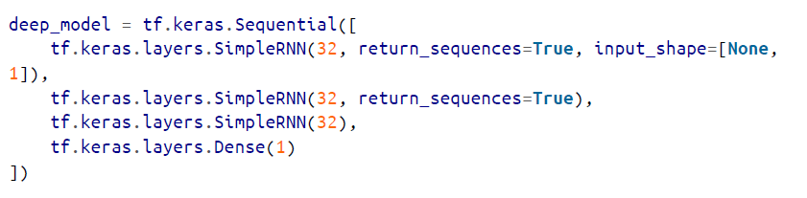
Deep RNN
Does not beat our shallow model

Slide 40
Forecasting Multivariate Time Series
Look at the colab link

